Slide 1





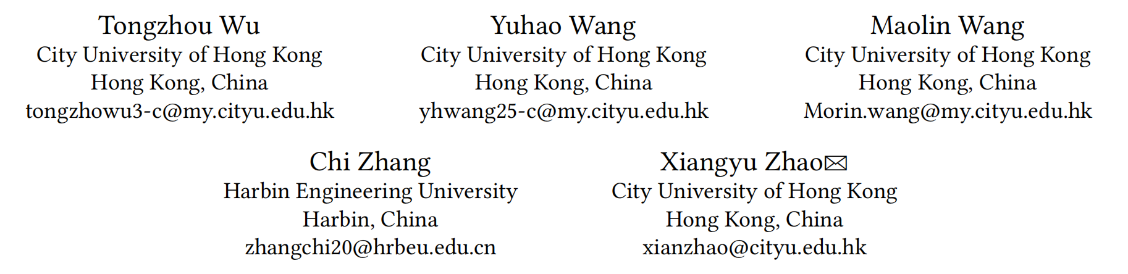





ATAI
Advanced Techniqueof Artificial Intelligence
ATAI
ChongqingUniversity _{AdvancedTechniqueof}
of Technology Artificial Intelligence
Chongqing University of
Technology
Chongqing University ^{ATAI}
_{of Technology} Advanced Techniqueof
Artificial Intelligence
Chongqing University of Technology
Chongqing University of Technology
Empowering Denoising Sequential Recommendation with Large
Language Model Embeddings
Code: https://github.com/Applied-Machine-Learning-Lab/IADSR.
2025.10.27
—— CIKM_2025
Reported by Yang Hu
1

Slide 2

ATAI
AdvancedTechniqueof
Artificial Intelligence
ATAI
ChongqingUniversity _{AdvancedTechniqueof}
of Technology Artificial Intelligence
ChongqingUniversity of Technology
Motivation
1.Sequential recommendation models are often influenced by noise such as accidental in-teractions, leading to suboptimal performance.
2.Exist approaches primarily focus on improving recommendation performance through architectural modifications, without explicitly addressing the inherent noise present in interaction sequences.
3.Simply relying on collaborative information may result in an over-denoising problem, especially for cold items.

Slide 3

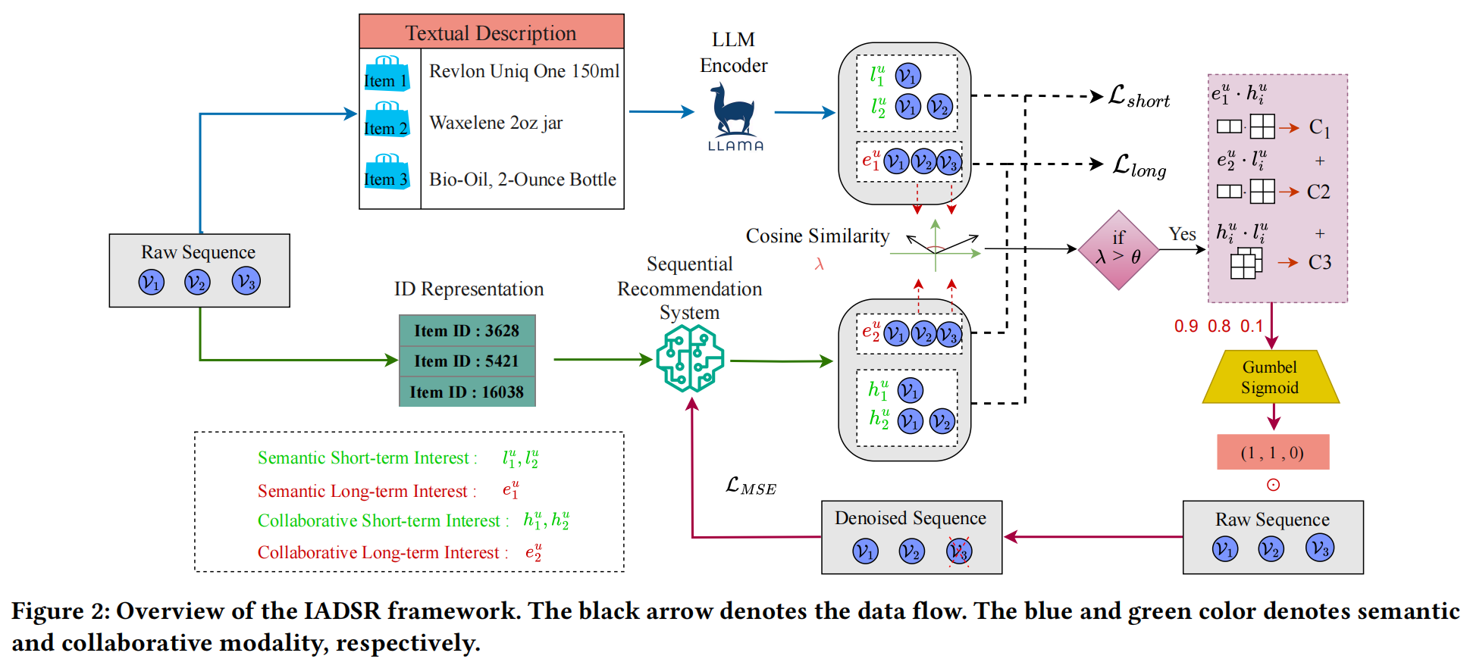
ChongqingUniversity of Technology
ATAI
AdvancedTechniqueof
Artificial Intelligence
ATAI
ChongqingUniversity _{AdvancedTechniqueof}
of Technology Artificial Intelligence
Overview

Slide 4
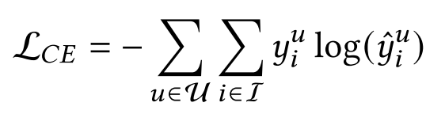
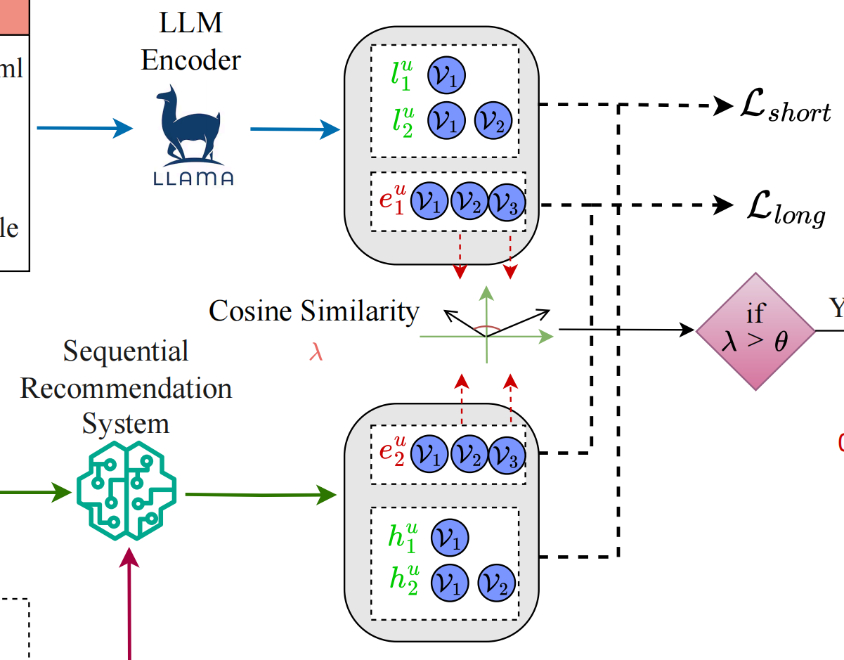
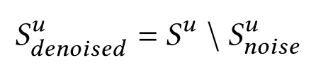
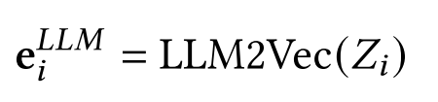

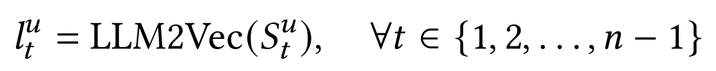

ChongqingUniversity of Technology
ATAI
AdvancedTechniqueof
Artificial Intelligence
ATAI
ChongqingUniversity _{AdvancedTechniqueof}
of Technology Artificial Intelligence
Method
(1)
(2)
(3)
(4)
(5)
(6)
(7)

Slide 5
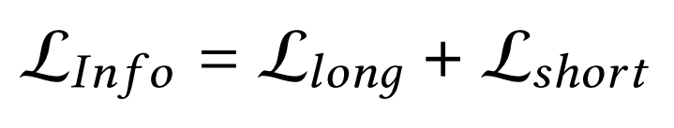
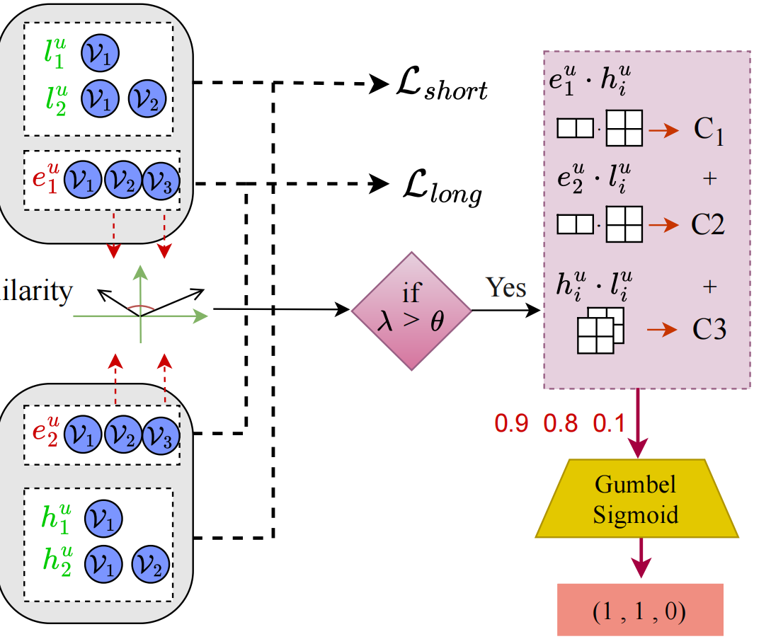
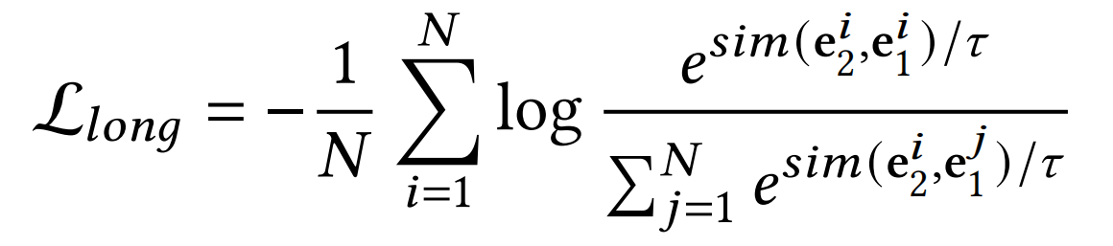
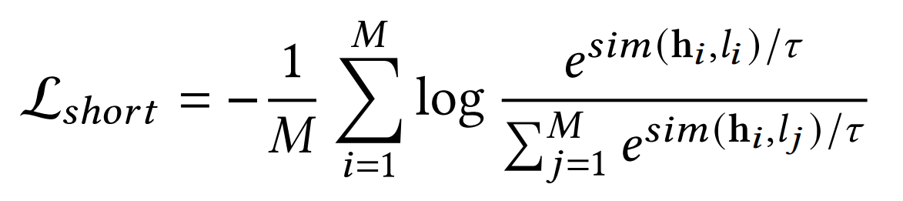
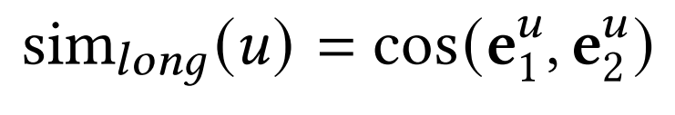
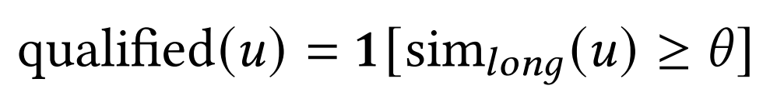
ChongqingUniversity of Technology
ATAI
AdvancedTechniqueof
Artificial Intelligence
ATAI
ChongqingUniversity _{AdvancedTechniqueof}
of Technology Artificial Intelligence
Method
(8)
(9)
(10)
(11)
(12)

Slide 6
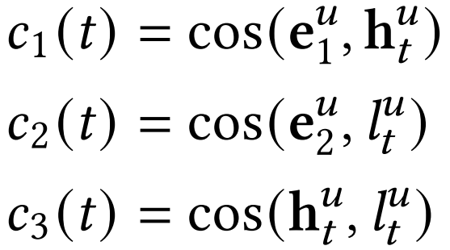
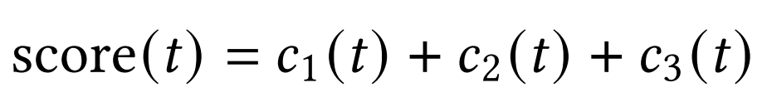
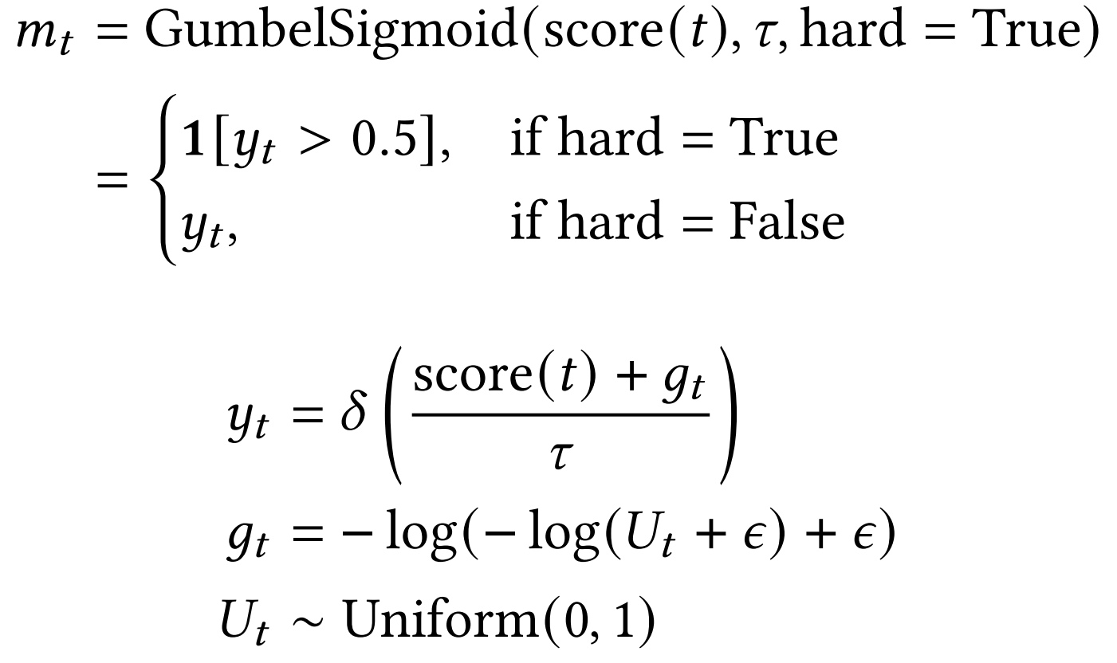
ChongqingUniversity of Technology
ATAI
AdvancedTechniqueof
Artificial Intelligence
ATAI
ChongqingUniversity _{AdvancedTechniqueof}
of Technology Artificial Intelligence
Method
(13)
(14)
(15)
(16)
(17)

Slide 7
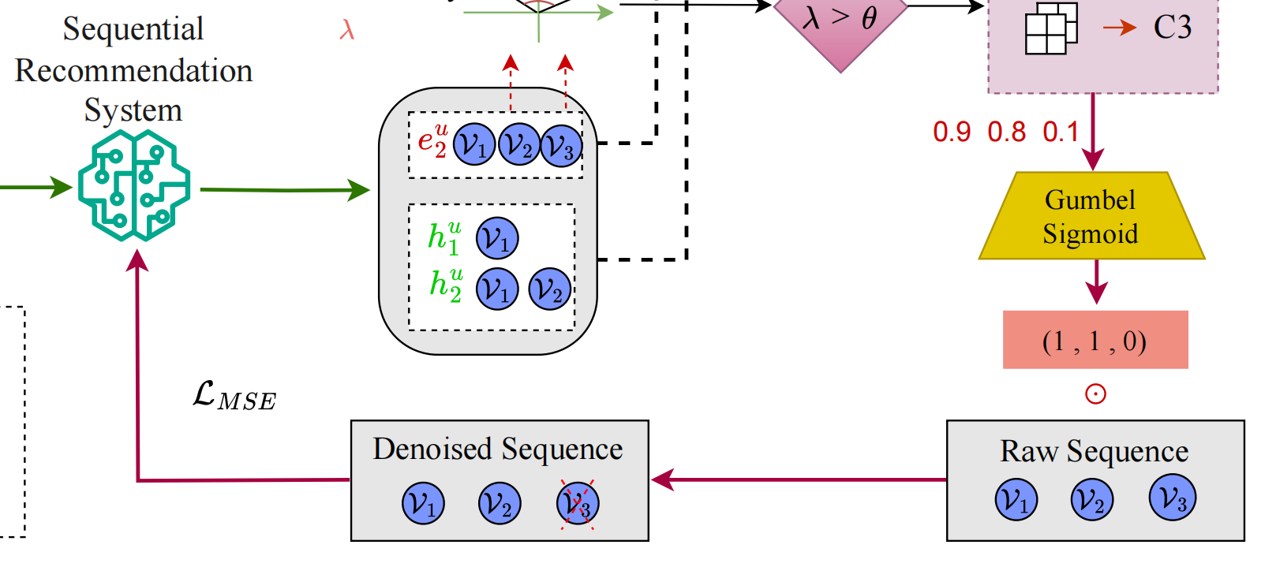
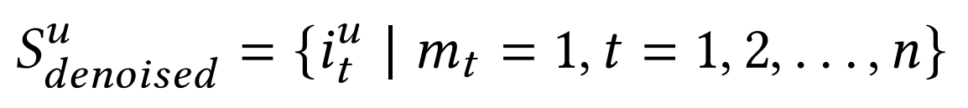
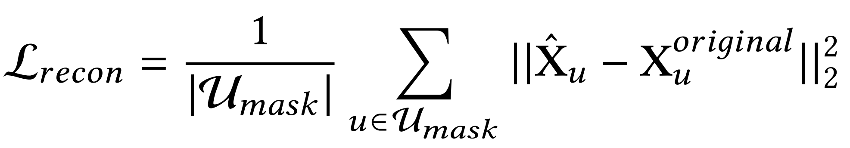
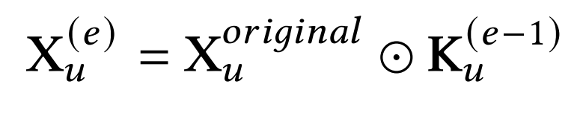
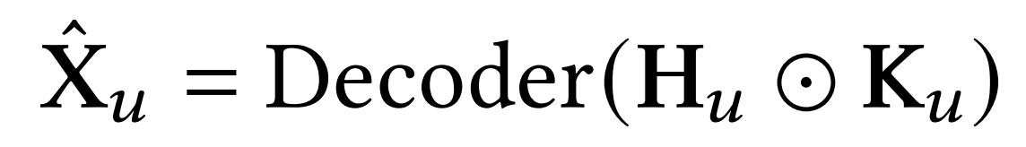
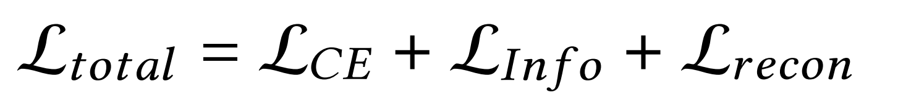
ChongqingUniversity of Technology
ATAI
AdvancedTechniqueof
Artificial Intelligence
ATAI
ChongqingUniversity _{AdvancedTechniqueof}
of Technology Artificial Intelligence
Method
(18)
(21)
(19)
(20)
(22)

Slide 8

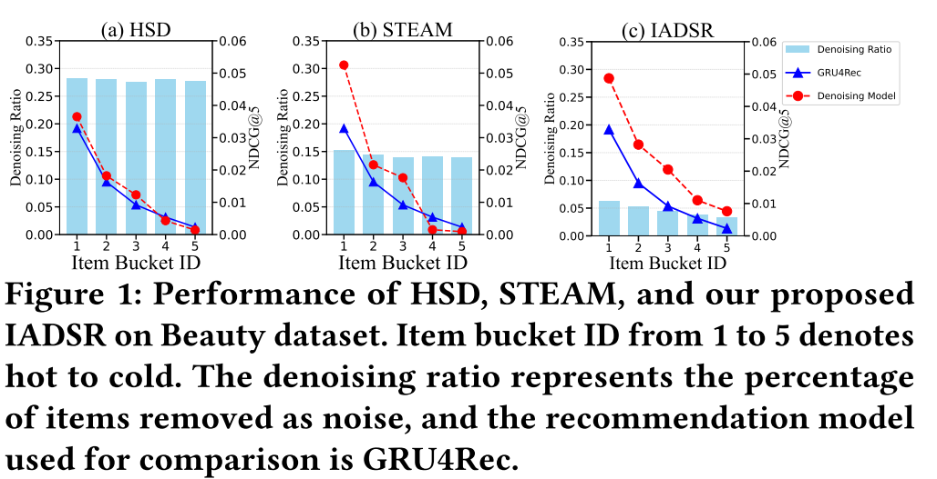
ATAI
AdvancedTechniqueof
Artificial Intelligence
ATAI
ChongqingUniversity _{AdvancedTechniqueof}
of Technology Artificial Intelligence
ChongqingUniversity of Technology
Experiments

Slide 9
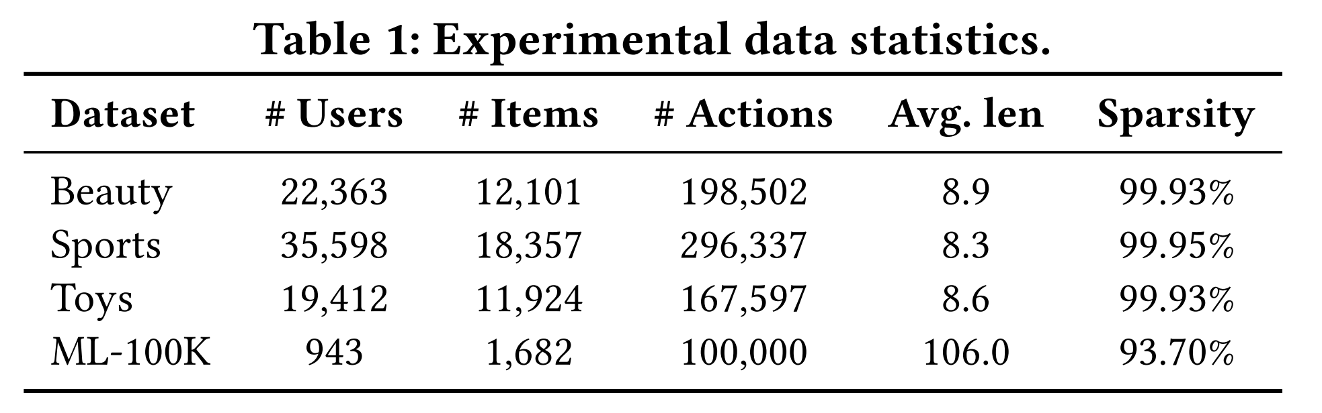
ATAI
AdvancedTechniqueof
Artificial Intelligence
ATAI
ChongqingUniversity _{AdvancedTechniqueof}
of Technology Artificial Intelligence
ChongqingUniversity of Technology
Experiments

Slide 10
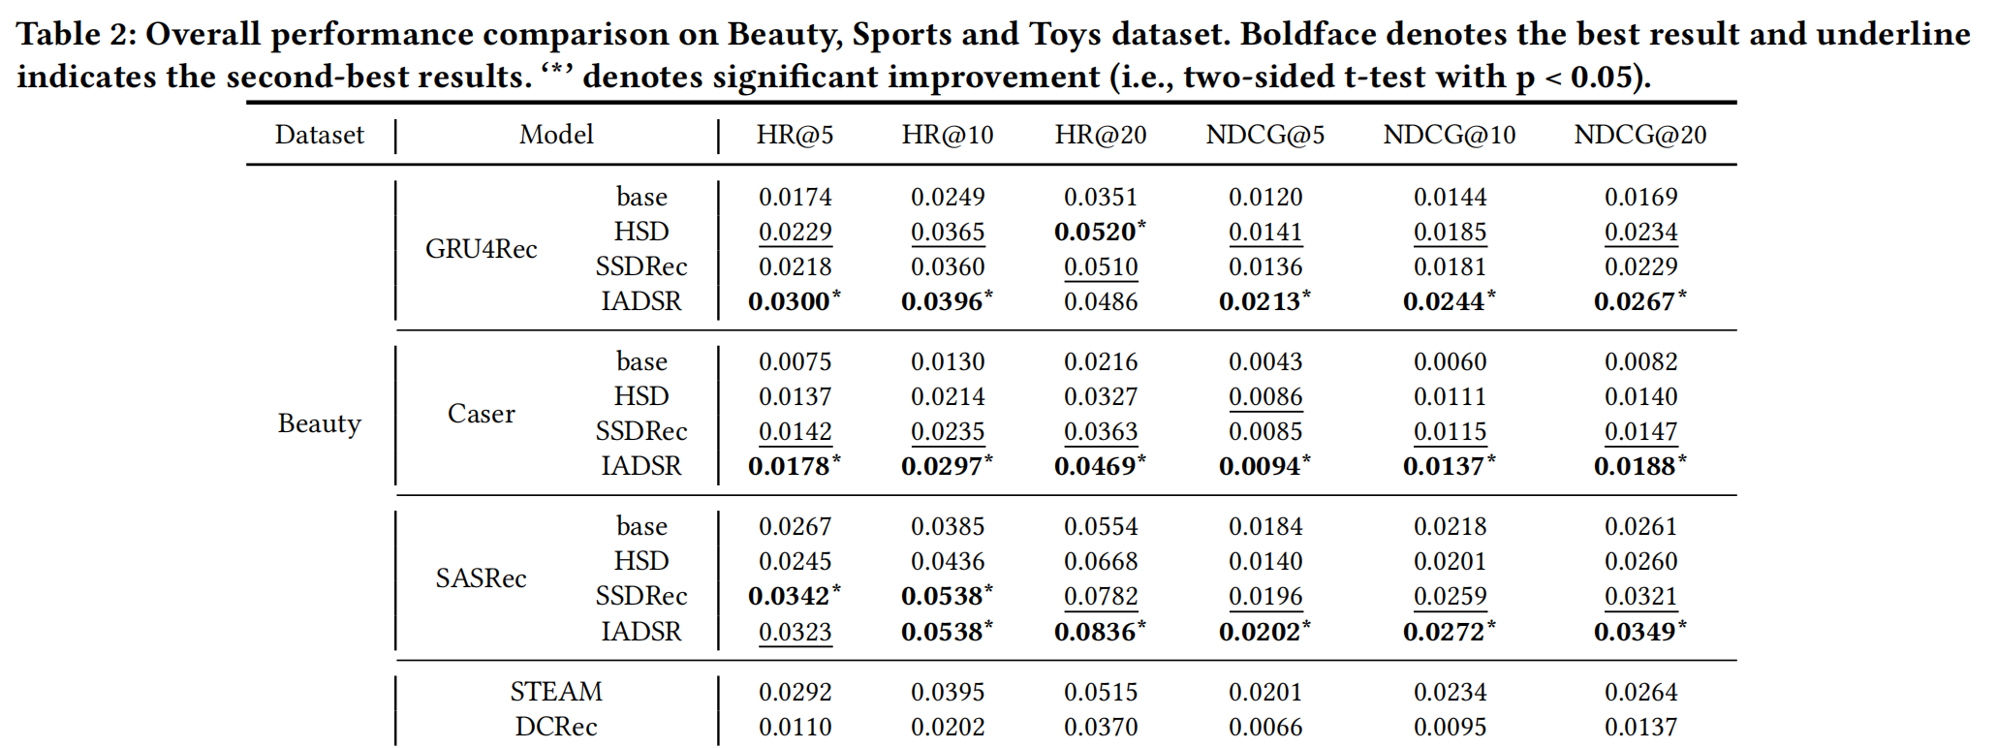
ATAI
AdvancedTechniqueof
Artificial Intelligence
ATAI
ChongqingUniversity _{AdvancedTechniqueof}
of Technology Artificial Intelligence
ChongqingUniversity of Technology
Experiments

Slide 11
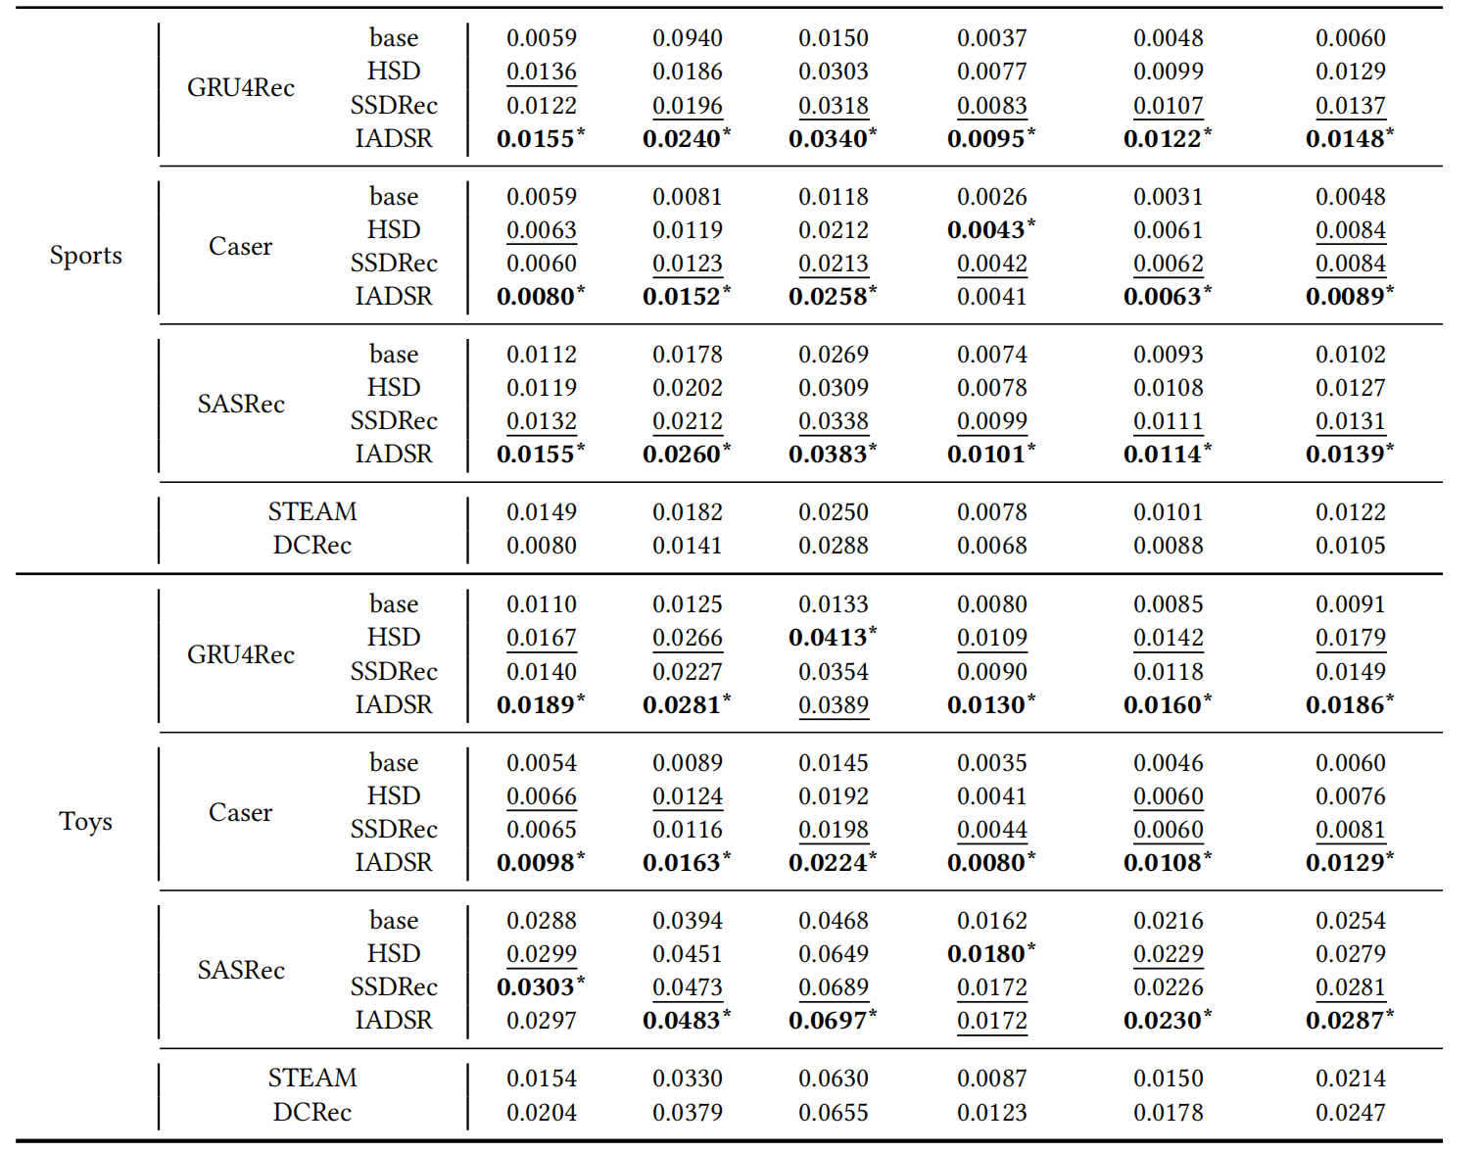
ATAI
AdvancedTechniqueof
Artificial Intelligence
ATAI
ChongqingUniversity _{AdvancedTechniqueof}
of Technology Artificial Intelligence
ChongqingUniversity of Technology
Experiments

Slide 12
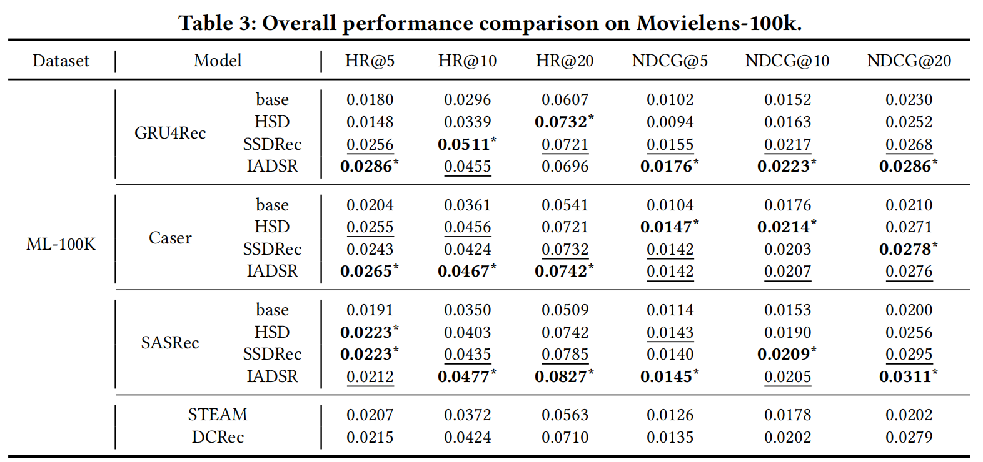
ATAI
AdvancedTechniqueof
Artificial Intelligence
ATAI
ChongqingUniversity _{AdvancedTechniqueof}
of Technology Artificial Intelligence
ChongqingUniversity of Technology
Experiments

Slide 13
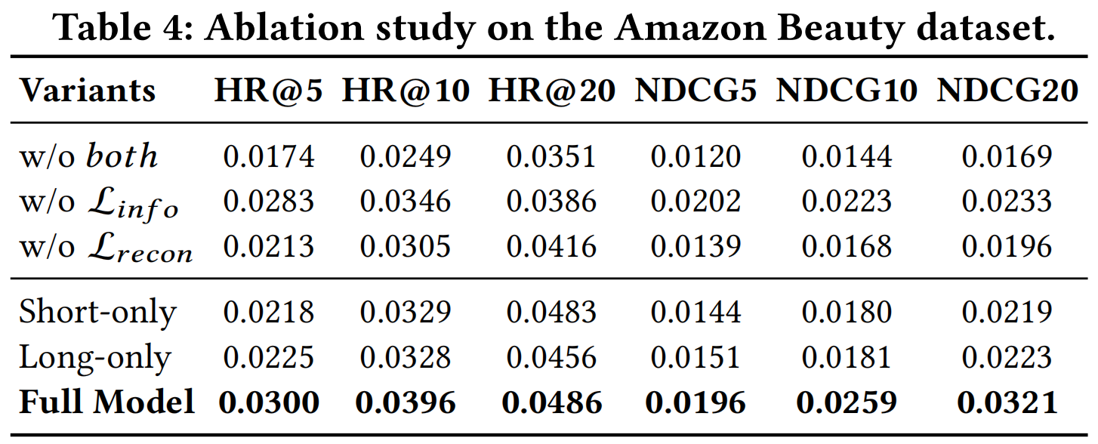
ATAI
AdvancedTechniqueof
Artificial Intelligence
ATAI
ChongqingUniversity _{AdvancedTechniqueof}
of Technology Artificial Intelligence
ChongqingUniversity of Technology
Experiments

Slide 14
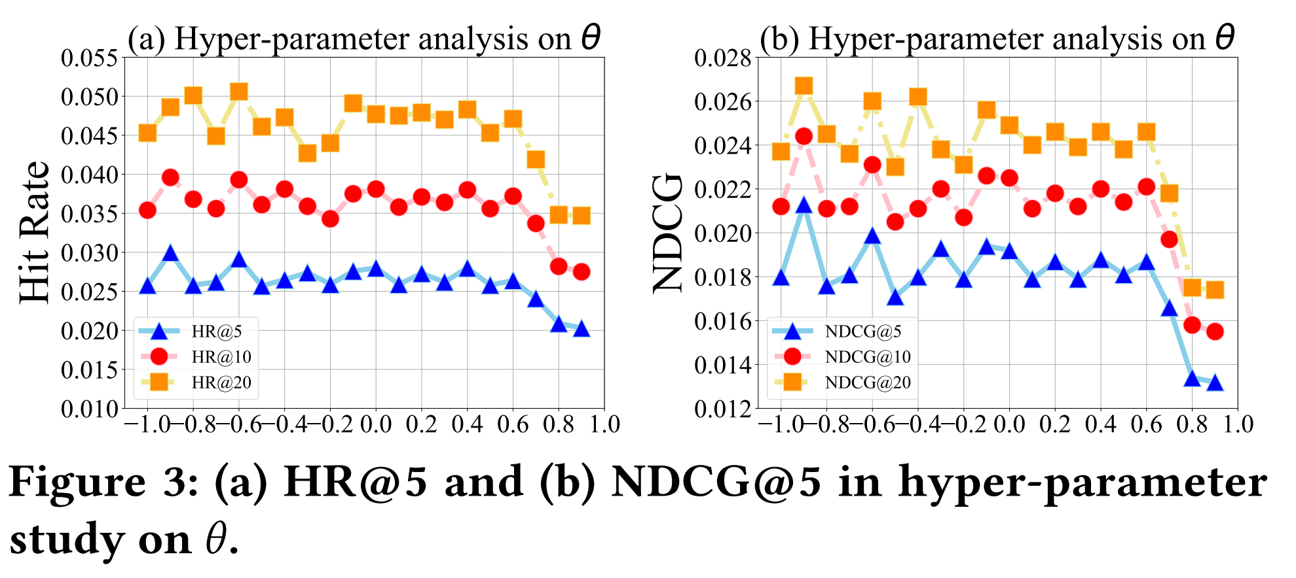
ATAI
AdvancedTechniqueof
Artificial Intelligence
ATAI
ChongqingUniversity _{AdvancedTechniqueof}
of Technology Artificial Intelligence
ChongqingUniversity of Technology
Experiments

Slide 15
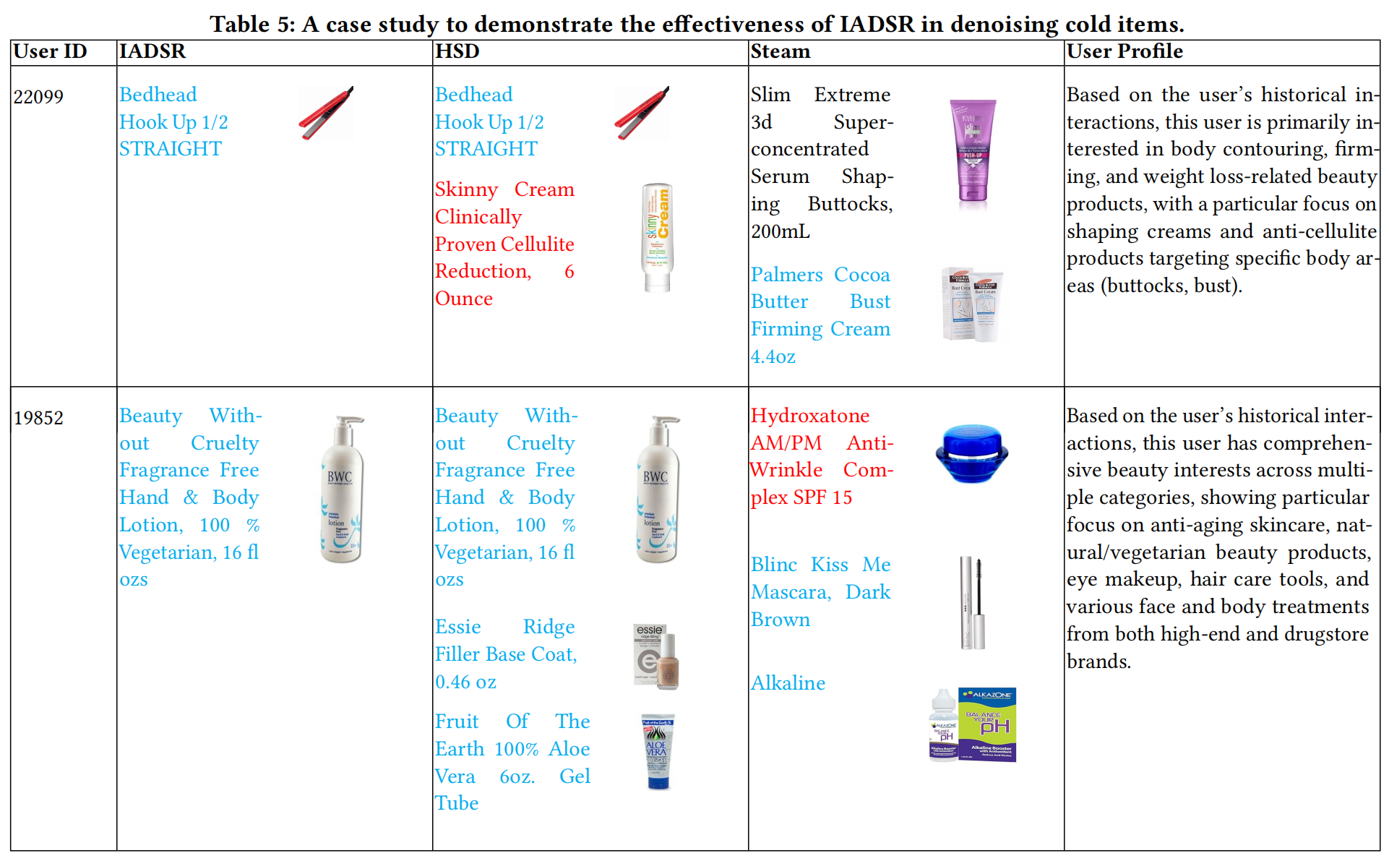
ATAI
AdvancedTechniqueof
Artificial Intelligence
ATAI
ChongqingUniversity _{AdvancedTechniqueof}
of Technology Artificial Intelligence
ChongqingUniversity of Technology
Experiments

Slide 16


ChongqingUniversity of Technology
ATAI
AdvancedTechniqueof
Artificial Intelligence
ATAI
ChongqingUniversity _{AdvancedTechniqueof}
of Technology Artificial Intelligence
Thanks!

